Slide 1


IMPROVET-AM
18 February 2026 | 12:30–14:00 (UTC+4)
Innovative Teaching and Digitalisation
Funded by the European Union. Views and opinions expressed are however those of the author(s) only and do not necessarily reflect those of the European Union or EACEA. Neither the European Union nor the granting authority can be held responsible for them.

Slide 2


Slide 3
OBJECTIVE
To strengthen the managerial capacity of VET institutions by providing practical tools, shared approaches, and structured peer learning that support the effective organisation, implementation, and sustainability of the IMPROVET-AM activities.

Slide 4



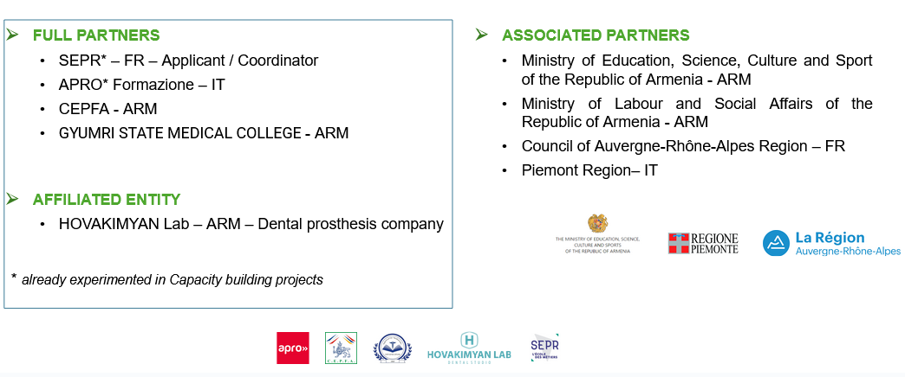
IMPROVET-AM Key Fact and Partnership
Capacity building in the field of Vocational Education and Training (VET)
Project duration: 1 December 2023 - 30 November 2026 = 36 months

Slide 5
IMPROVET-AM Objectives
The project aims at improving qualifications within the health sector in Armenia, with a specific focus on Dental Prosthesis and Health Care & Personal Assistance. Beyond skill enhancement, the project extends to the development of comprehensive professional guidance for Armenian learners, families, and the broader public. By incorporating modern educational methods and embracing digital, eco-friendly and inclusive approaches, the project strives to tailor training programs to meet both current and future demands of the job market.

Slide 6
Project Expected Activities
Creation of new and innovative training modules in dental prosthesis and health care, for both initial and continuous VET
Implementation of new training materials and pedagogical approaches, integrating digital tools
Capacity building of teachers and management staff
Strengthening the skillset of guidance operators by equipping them with innovative practices and tools to effectively address the diverse guidance needs of both students and adults.

Slide 7




Good Practices Catalogue for Teachers

Slide 8
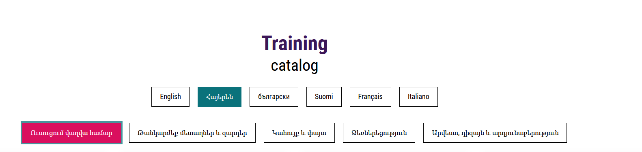
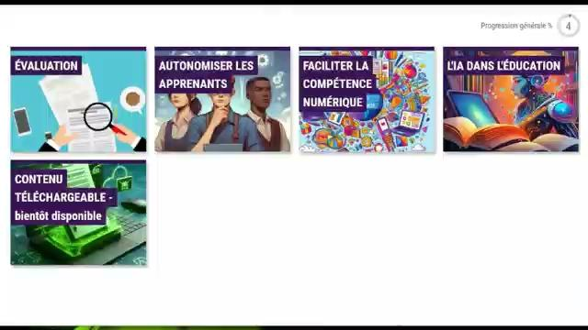



MOSAIC Modules for Teachers

Slide 9


Slide 10




Icebreaker Activity
Write an intention in the chat by completing this sentence:
“By the end of this webinar, I hope to ______.”
Funded by the European Union. Views and opinions expressed are however those of the author(s) only and do not necessarily reflect those of the European Union or EACEA. Neither the European Union nor the granting authority can be held responsible for them.

